Slide 1
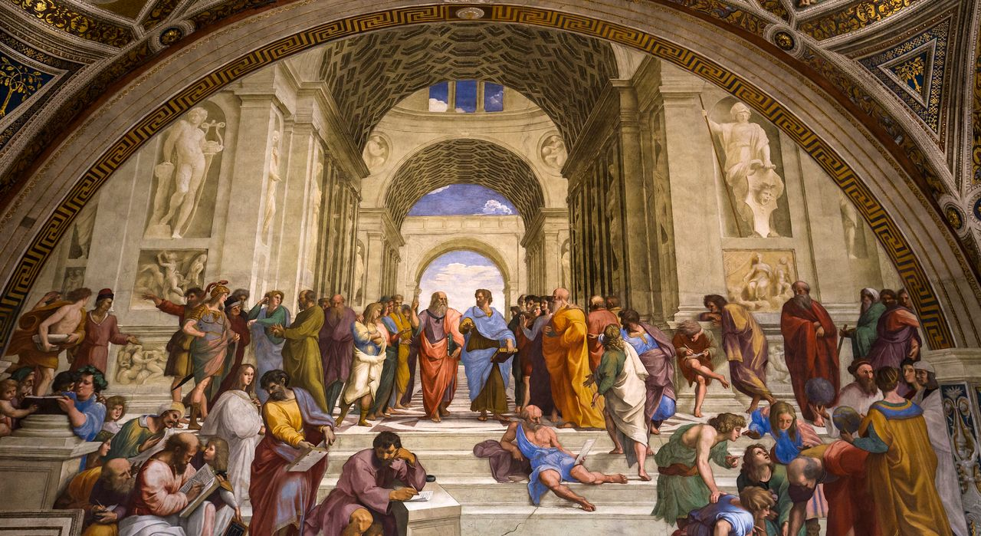
Dining Philosophers
By: Oliver and Jason

Slide 2

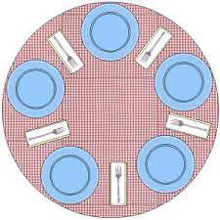
The Problem
In the problem there are five philosophers that alternate between eating and thinking. On the table there are five sticks, when a philosopher wants to eat is must pick up the stick to his left and right when they are available. He then must eat and then set them down and begin to think again.

Slide 3
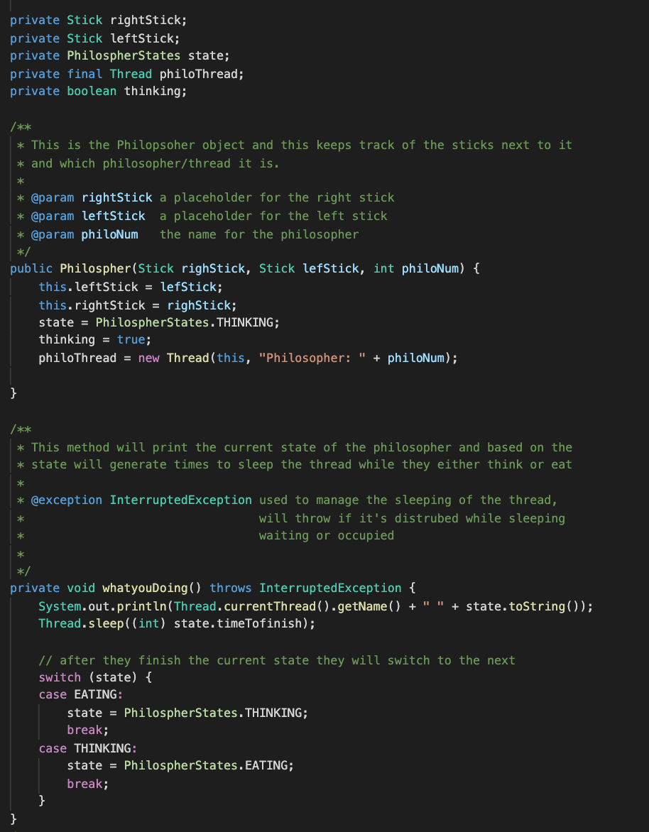
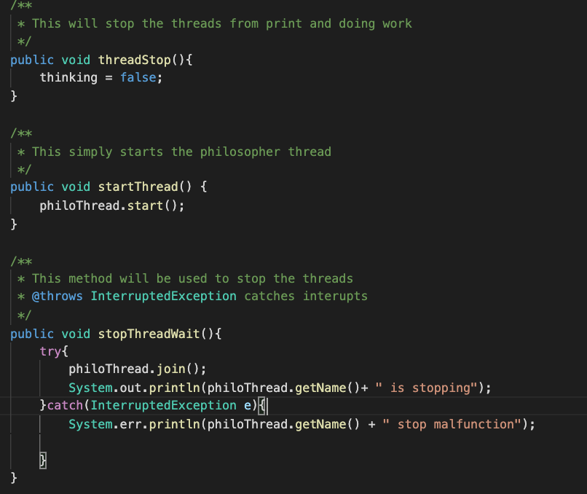
Philosopher Class

Slide 4
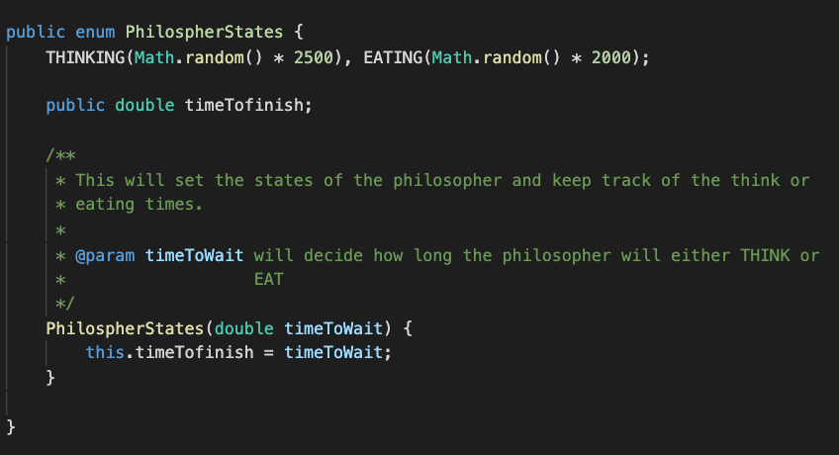
Philosopher States
Our Philosopher States enumerator we create two different state THINKING and EATING and assign them a random wait time. The wait time is used later to decide the how long each state will last.

Slide 5
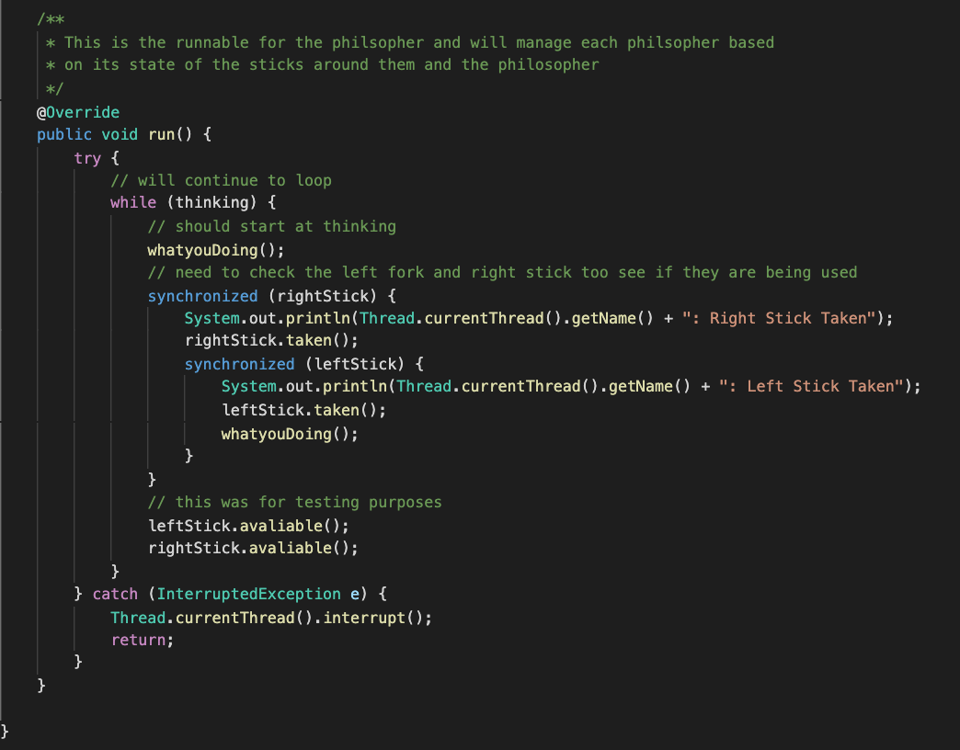
The RUN Method
In our run() method, we run the method whatyouDoing() and then attempt to pick up the right stick and if they achieve this it will then attempt to pick up the left stick. Both the left and right stick are synchronized so they can’t be picked up if a different philosopher is using them. Once both sticks are picked up it will eat and then release both sticks.

Slide 6
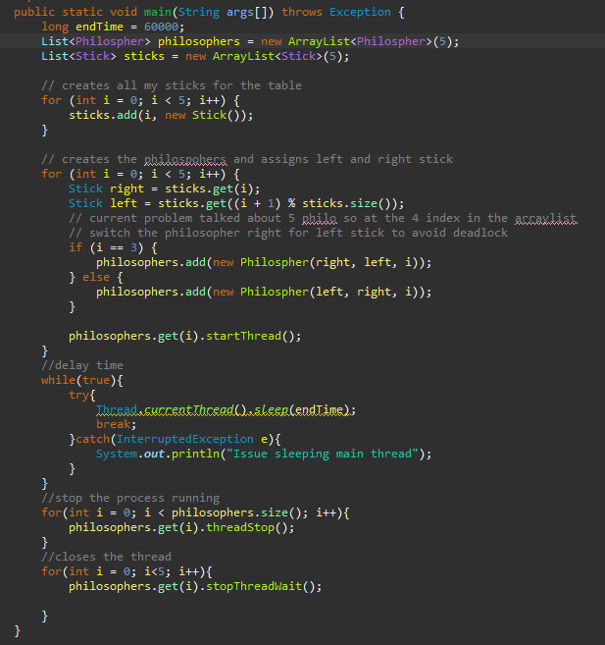
Main Method
For our main method, we simply create two storage systems one for our philosophers and the other for our sticks. We then assign our sticks to the philosophers and start their threads. We sleep the main thread for a 60 seconds and stop the threads.

Slide 7
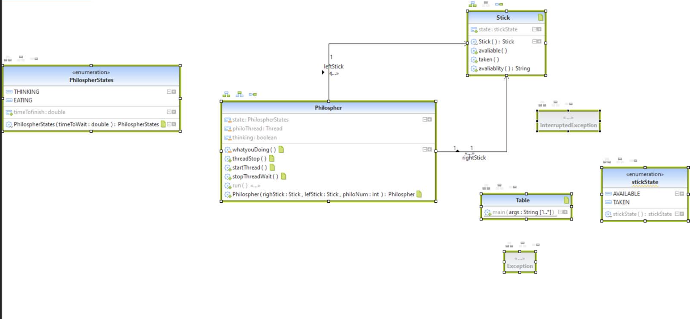
UML Diagrams

Slide 8
Challenges faced
Deadlocks
Stick Assignment
Philosopher

Slide 9


